Slide 1
Garmin Run Data
Jenny Kim, Atlanta Liu & Lawrence Shao

Slide 2
Research Questions
Where and when does timestamp mismatch occur in the Garmin dataset?
How does time spent sleeping affect perceived workout intensity?
What patterns can be revealed from using K-Means cluster across all cont. variables? (e.g BPM, Distance, Speed, and Altitude)
For individuals that run the most, do they exhibit any changes in the spread of their heart rate the more they run?

Slide 3
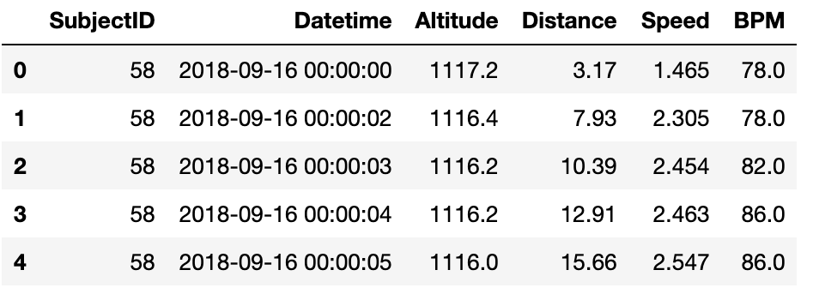
Data Cleaning
Garmin Data
Final dataframe consisted the following columns:
Subject ID | Datetime
Altitude | Distance
Speed | BPM
Notes:
Python and Tableau software were used to read, analyze, and visualize the data
Dropped average bpm that is less than 100 across the entire run
Wanted to get rid of resting bpm. Resting bpm is between 60-100

Slide 4
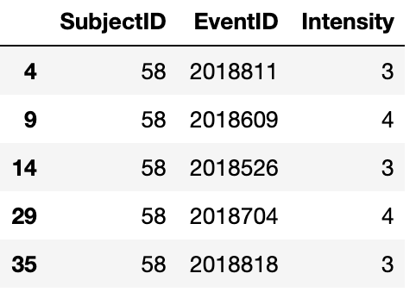
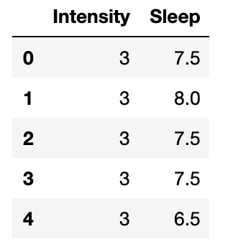
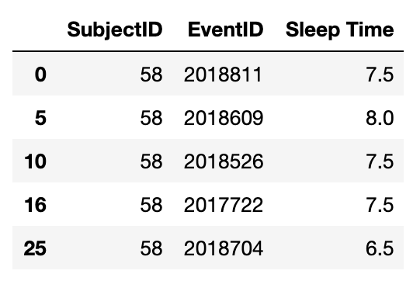
Data Cleaning
Survey Data
Notes:
The survey data was used to see the associations between sleep and workout intensity.
Two dataframes were cleaned and created for sleep and intensity responses and were merged together

Slide 5
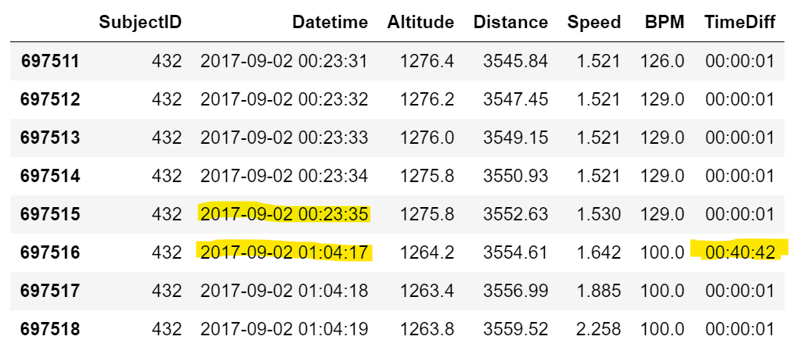
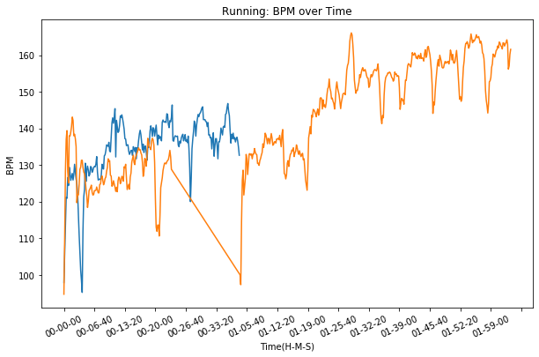
A Jump in Time
Notes:
We ran into a few difficulties regarding missing data.
On the left is the original dataframe, the highlights show what missing timestamps appear like.
The right shows a visual representation of what missing timestamps appear like on graphs (orange), blue is used for comparison to normal running bpm measures.
Garmin watch malfunctioning or the runner took a break?
So we took a further look at when these missing timestamps occurred

Slide 6
Missing Data
 | Multiple Times In a Run (63 rows) | One Time In a Run (158 rows)
Median Altitude (m) | 1065 | 1063
Median Distance (m) | 8638 | 3589
Median Speed (m/s) | 0.112 | 1.222
Median BPM | 108 | 100
Median Time Difference (H-M-S) | 00:03:05 | 3:14:50
Notes:
Missing timestamps occur across every runner, sometimes it occurs multiple times in the same day, sometimes only once a day.
We looked at missing time differences that are 1min or more.
- If we look at the median measures for each variable, the largest difference occurs in the time and speed.
For missing data that occurs multiple times on the same day, it seems like time differences are much shorter and the overall speed is much less
- This indicates that there is likely to be more small breaks on the same day, where most people are stationary.
For missing data that occurs only once a day, the time difference is much greater and individuals are at walking speed.
-This indicates that people who take a break one time take a break for a longer period of time but are moving.

Slide 7
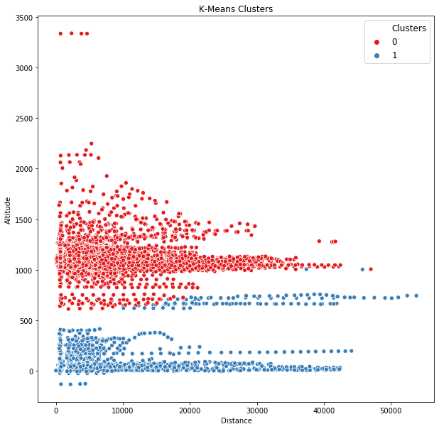
Results
K-Means Cluster
K-means clustering with 2 clusters was performed
From the two clusters we can infer that people in higher altitudes tend to run shorter distances when compared to those in lower altitudes
 | Cluster 0 | Cluster 1
Mean BPM | 140.27 | 137.57
Mean Altitude | 1094.62 | 149.46
Mean Distance | 7101.39 | 12026.12
Mean Speed | 2.31 | 2.35
Notes:
Clustered with all the variables
Got 2 clusters with altitude and distance

Slide 8
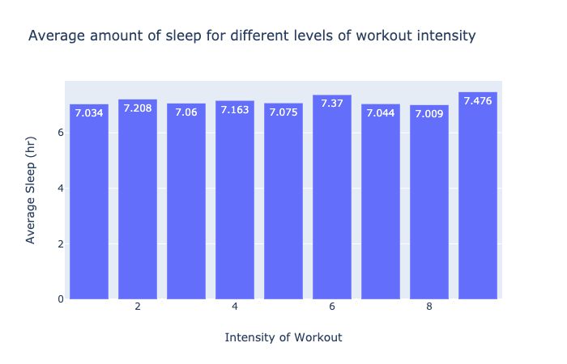
Results
Associations between sleep and workout intensity:
Survey data was used to determine the amount of sleep and workout intensity for every runner
Average sleep was calculated for each level of workout intensity
No strong relationship between sleep and workout intensity

Slide 9
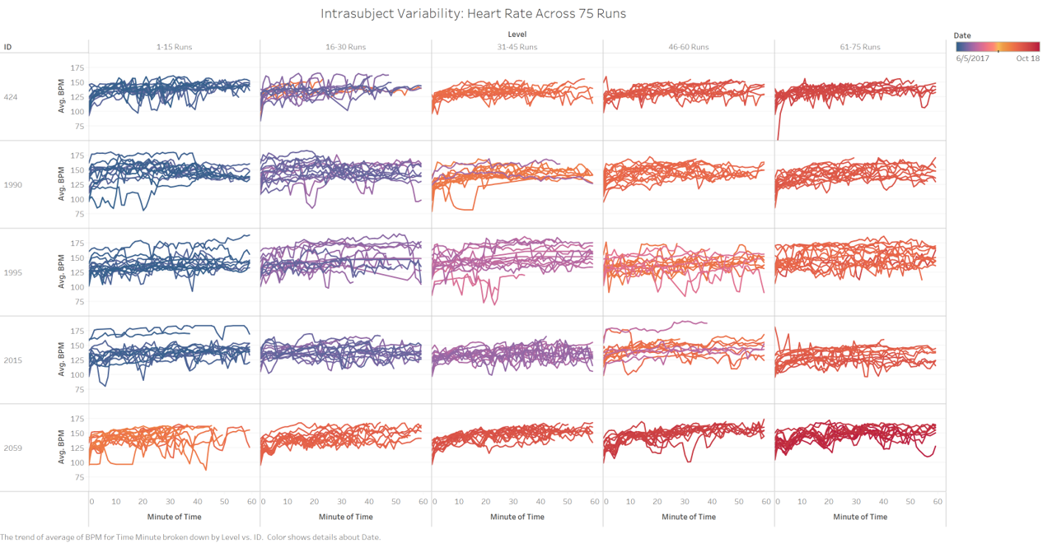
Results

Slide 10
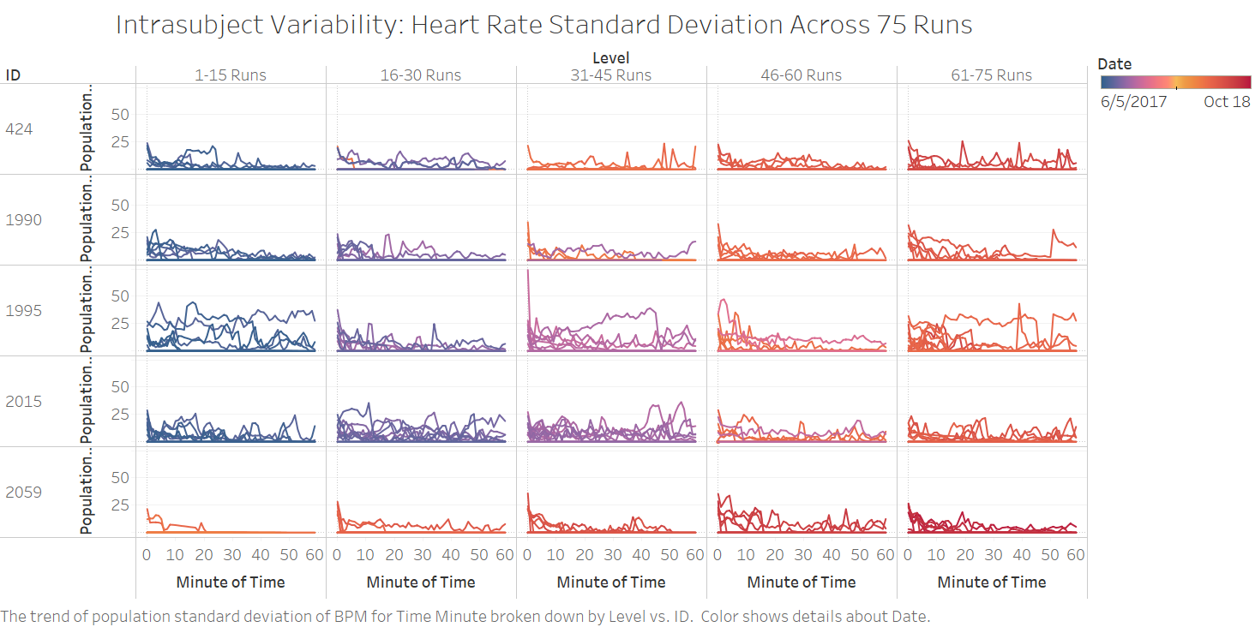
Results

Slide 11


Conclusion
Missing Timestamps
Sleep & Workout Intensity
Shorter timestamp differences if it occurs multiple times on the same day.
No relationships were found between average time spent sleeping and perceived workout intensity
​
K-Means Cluster
Top Runners
Subjects located in higher altitudes will tend to run for shorter distances, whereas individuals in lower altitudes tend to run farther.
For individuals that run the most, we did not observe huge changes in the spread of their heart rate as they run

Slide 12
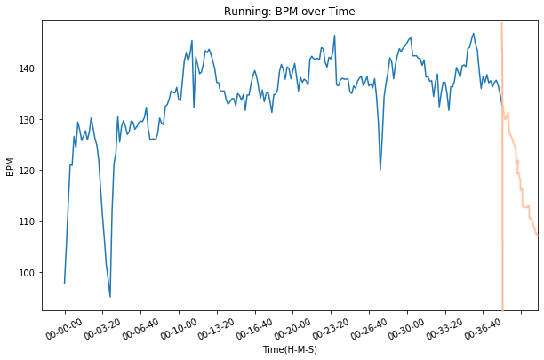
Further Research & Application
Heart Rate Recovery & Injury Prediction
Can data in heart rate recovery be used to improve injury prediction results?
Implementing a Cooldown Timer
Instead of stopping all measurements immediately after the end of the run, program it to continuously measure BPM for 1 minute afterwards.
Post-run: Heart rate recovery begins
Understanding Missing Timestamps
The cooldown timer also serves as a visual indicator to understand when a subject purposefully stops their run.
Notes:
Currently, many of the subjects in the dataset do not show post-exercise heart rate. However, there is a lot of data to be gained in this region. Heart rate recovery is able to provide information about the likelihood of an individual acquiring cardiovascular disease later in life and even mortality. For our interest, HRR can be used to indicate the level of fatigue, overall fitness level, as well as training load.
Could you look at a person's change in gait pattern, combined with differing heart rate recovery to improve injury prediction results?
There is a lot of research that can be done in this topic, and most research has focused on only particular groups. Can we apply it in a broader spectrum with wearable tech? (Implement cooldown timer, 1-2min)
Garmin watch malfunctioning or the runner took a break? Helps us eliminate potential noise in the data.

Slide 13
THANK YOU

